Slide 1
Image Captioning Project
S.Gokul Raj

Slide 2
What is Image Captioning?
Image Captioning is the task of automatically generating textual descriptions for an image.
It combines Computer Vision (to understand objects, scenes, and context) and Natural Language Processing (NLP) (to form meaningful sentences).
Example: Given a picture of a dog playing with a ball, the system generates the caption “A dog is playing with a ball on the grass.”

Slide 3
Purpose of Image Captioning
Accessibility – Helps visually impaired users by describing images.
Content Management – Enables automatic tagging, indexing, and organization of images.
Human–AI Interaction – Enhances chatbots, virtual assistants, and robotics with visual understanding.

Slide 4
How is Image Processed?
Step 1 – Input Image: An image is given as input to the system.
Step 2 – Preprocessing: The image is converted into a standard format (e.g., resized, converted to RGB).
Step 3 – Feature Extraction: A vision model (like CNN or Vision Transformer) analyzes objects, shapes, and context.
Step 4 – Encoding: The extracted visual features are turned into numerical representations the model can understand.
Step 5 – Caption Generation: A language model (decoder) converts these features into a meaningful sentence.

Slide 5
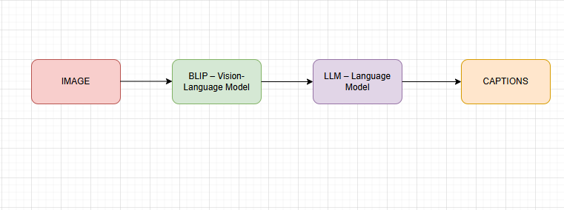
Project Workflow

Slide 6
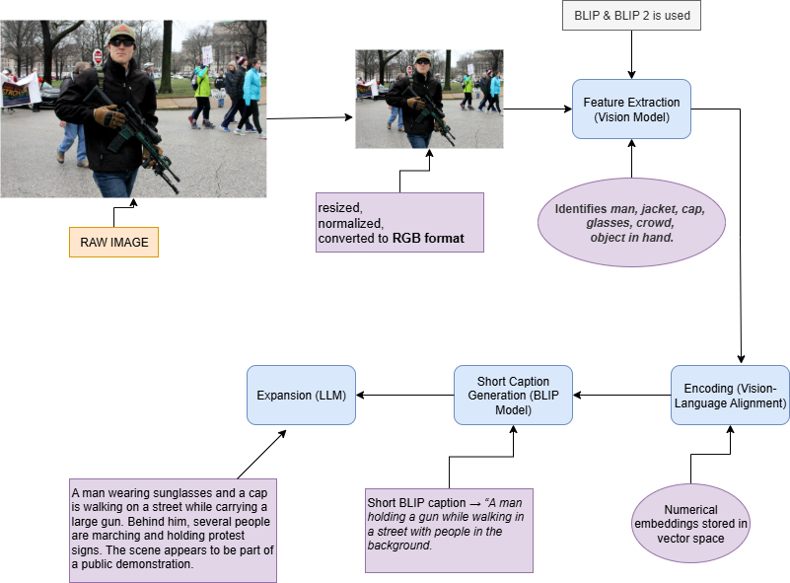

Slide 7
BLIP | BLIP 2
Bootstrapping Language-Image Pretraining | Bootstrapping Language-Image Pretraining 2
2022 | 2023
Has its own decoder for captions | Relies on powerful LLMs (like Flan-T5, Vicuna, OPT) for detailed text
Basic image captioning and VQA , Short captions (1 sentence) | Longer, richer, human-like descriptions, Detailed explanations, reasoning, multi-sentence outputs
LIMITATIONS:- Captions are short, less detailed | Requires more compute (heavier model)

